Slide 1
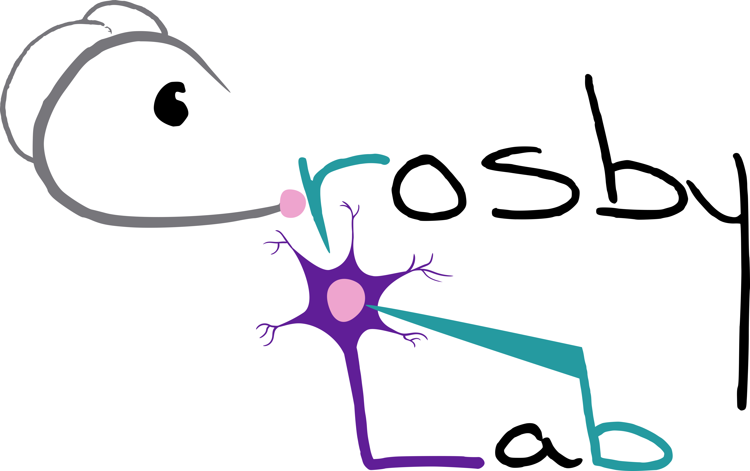


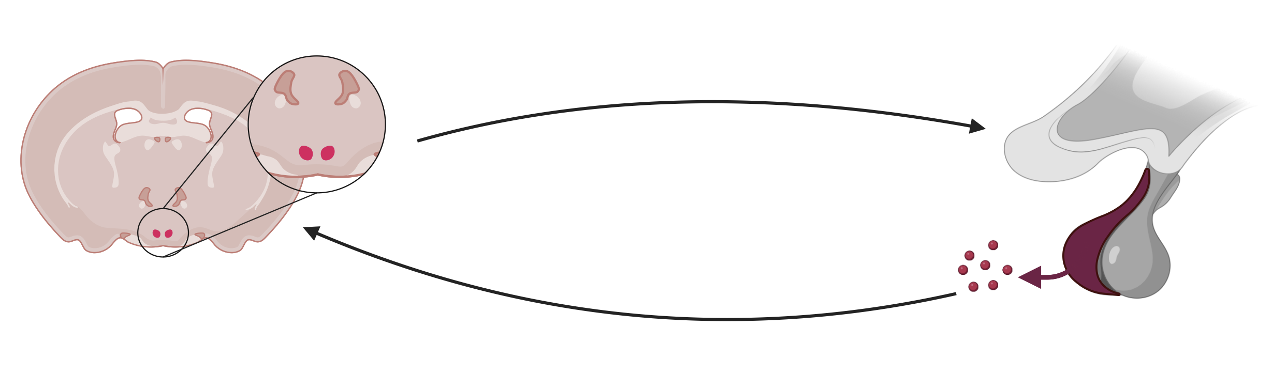
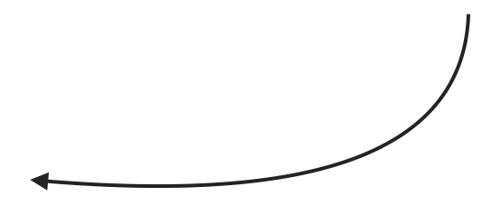
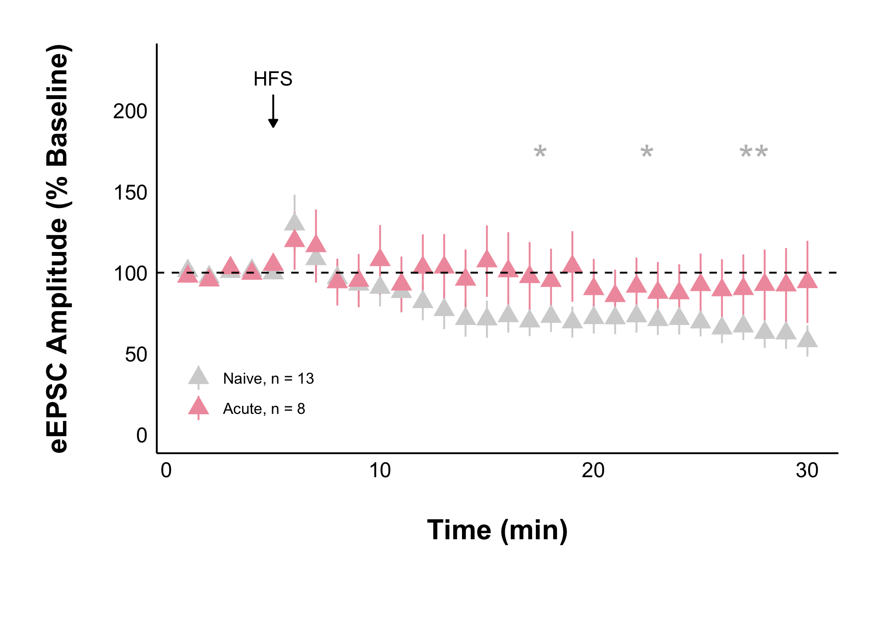
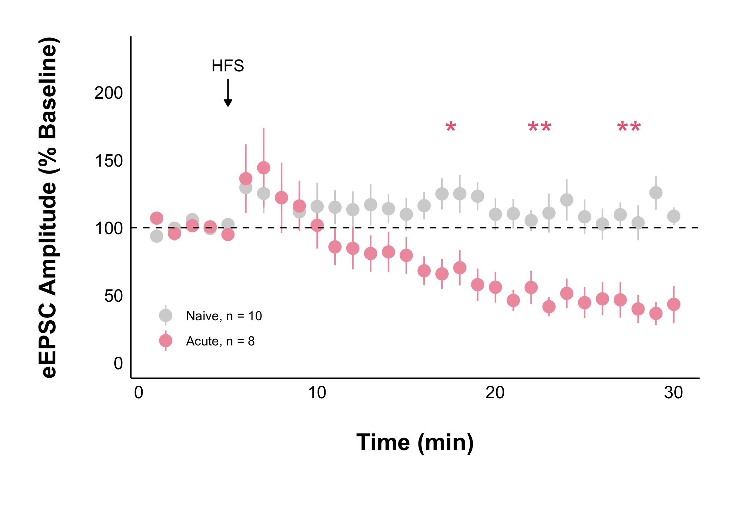
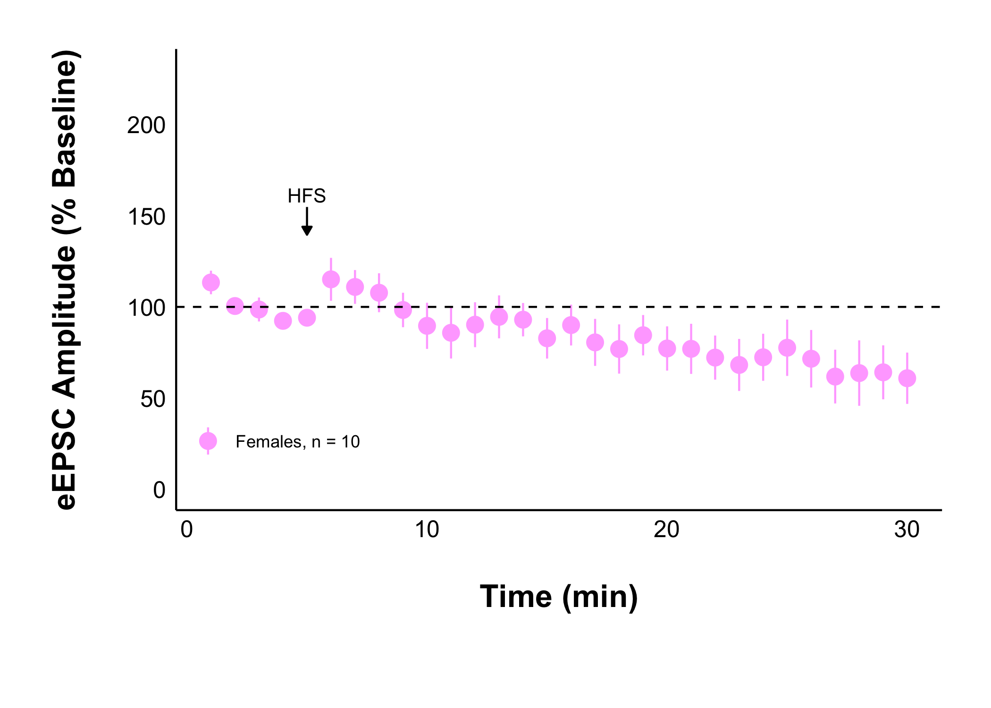
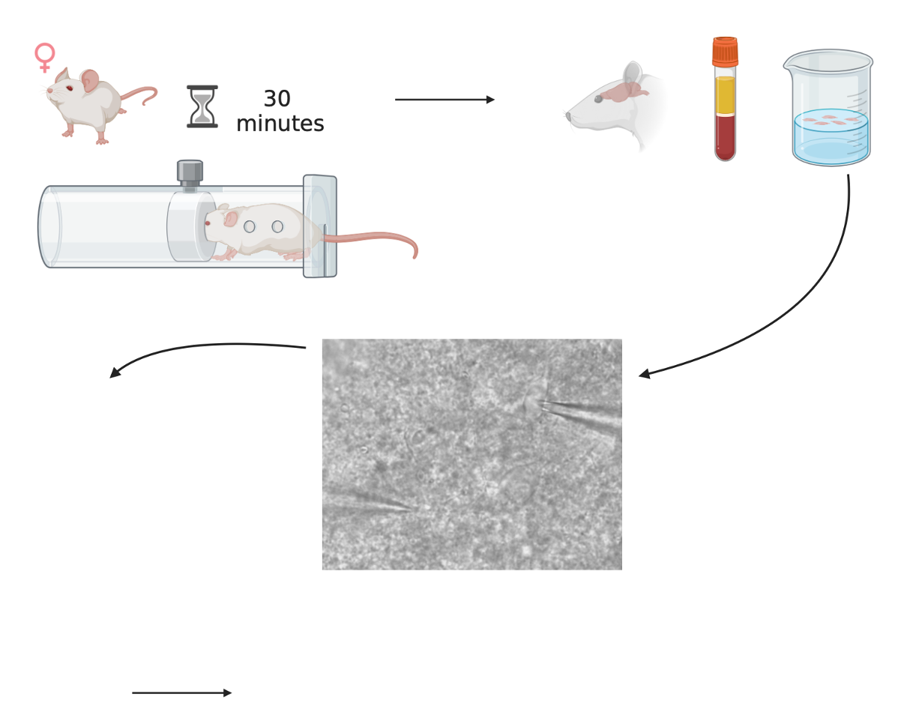
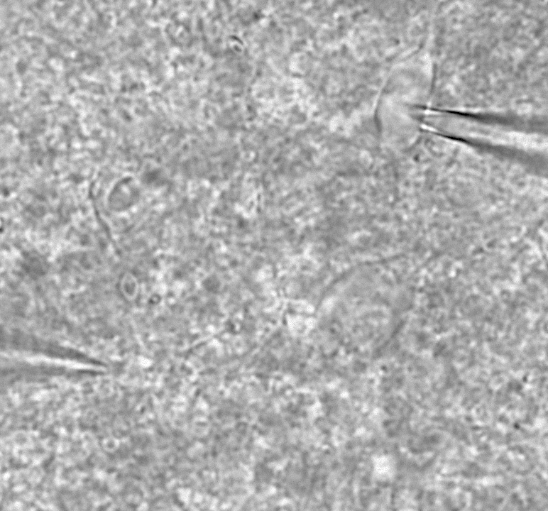
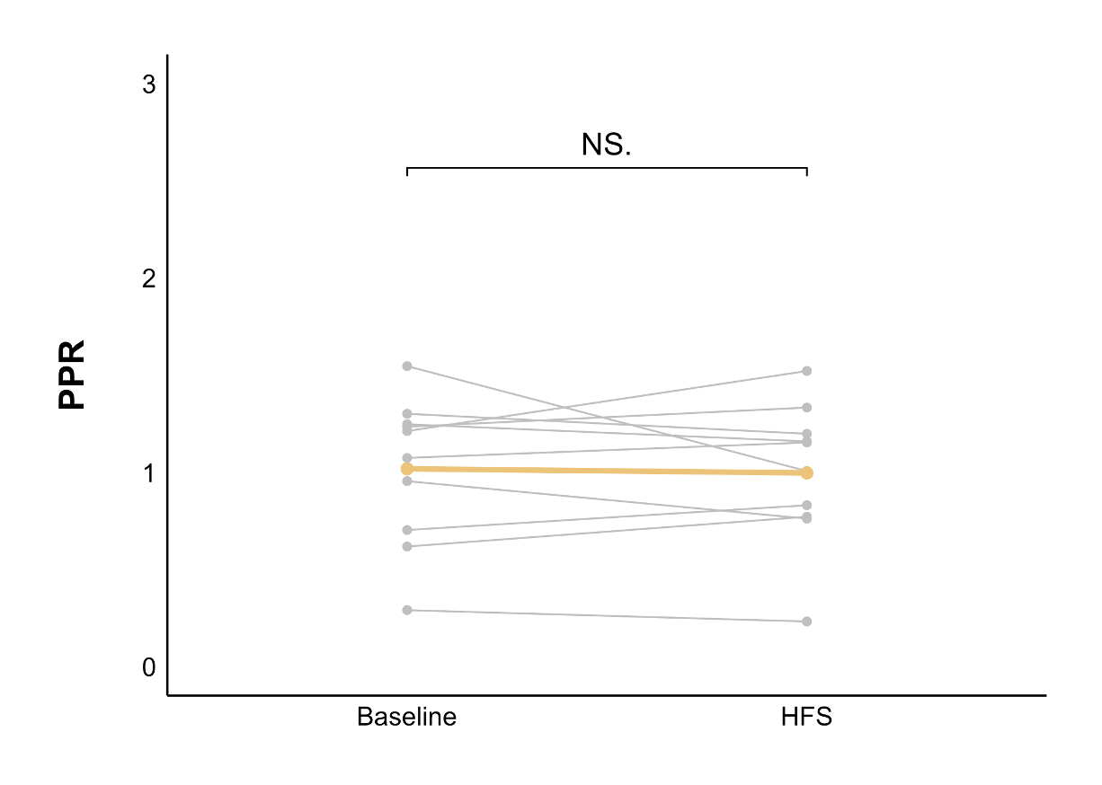
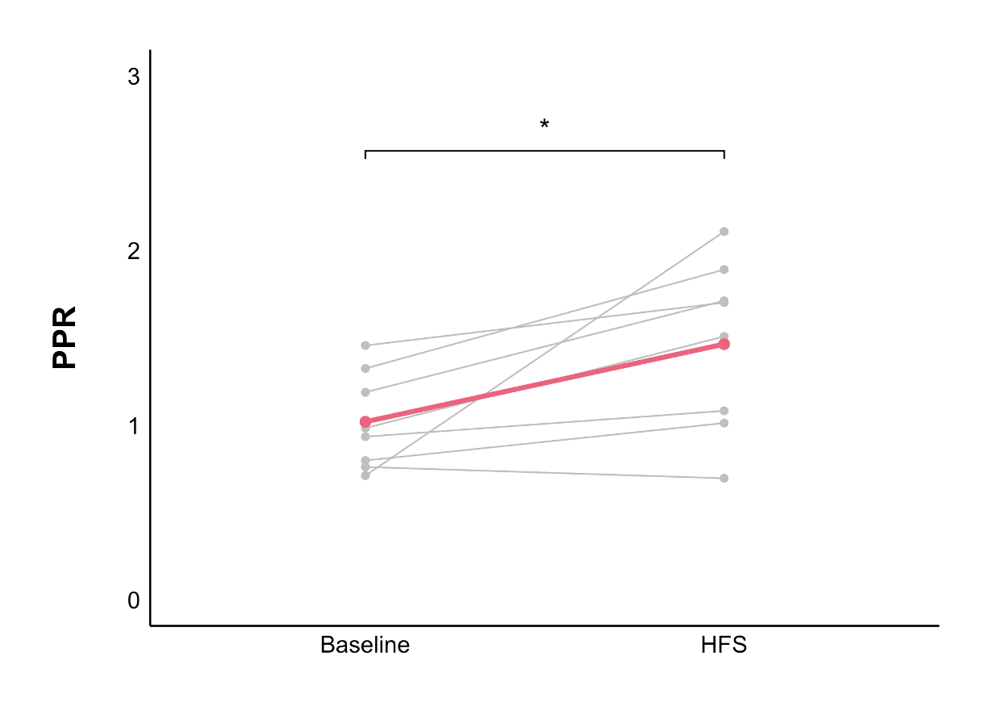
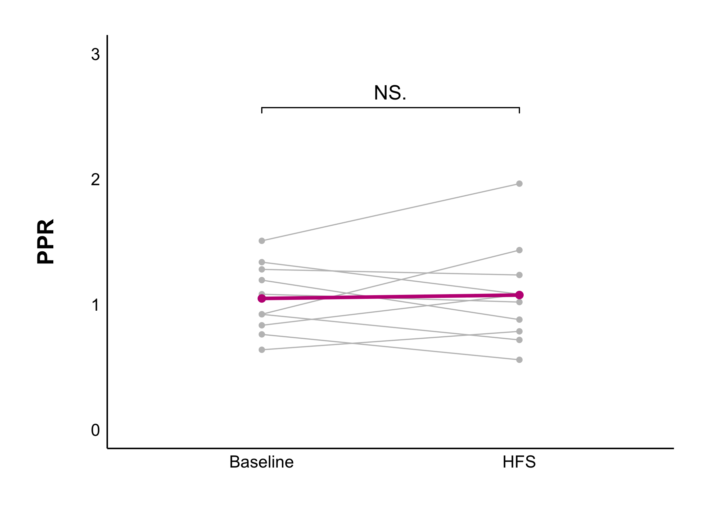
Acute Stress Decreases Glutamate Transmission through Endocannabinoid-CB1 Receptors
in the Female Rat Dorsomedial Hypothalamus
Ruby Muzzatti, Lara Swart, Sarah Wilson, Tania W, Dr Karen Crosby
Department of Biology, Mount Allison University, Sackville, New Brunswick, Canada
BACKGROUND
Using glutamate and GABA, the DMH projects to the paraventricular nucleus
Stress response mechanisms have not adapted to our high stress society and landscape of high calorie, highly palatable foods⁷. Women are particularly vulnerable to disordered eating behaviours when stressed⁵, for which the neurophysiological basis is unclear. Yet, female research subjects remain underrepresented, which this research aims to address.
The dorsomedial hypothalamus (DMH)
is a brain region
involved in appetite and body weight regulation¹, and the stress response²
where stress
hormones are produced³
DMH neurons have receptors for stress hormones⁴
How acute stress in females affects glutamatergic DMH transmission to ultimately influence appetite is unknown
METHODS
All experiments were performed according to protocol #104140 approved by the Mount Allison University Animal Care Committee in accordance with the Canadian Council on Animal Care Guidelines
RESULTS
What causes this decrease?
Acute stress in females triggered a long-lasting depression in glutamate transmission compared to naïve, but not in males
Endocannabinoids can trigger
a long-lasting decrease in glutamate release
Young, female Sprague-Dawley rats were exposed to a single restraint stress
They were anesthetized, euthanized, and their brains were quickly removed
Male
Female
Acute Female with 5 µM AM251
There is no longer a long-lasting decrease in glutamate under acute stress when CB1 receptors are blocked
Immediately following brain removal, a carotid blood sample was collected
A paired t-test was used to compare each 5-minute interval to the 5-minute baseline period. * = p-value < 0.05, ** = p-value < 0.01
250 µm
coronal brain slices containing the DMH were kept alive in oxygenated artificial cerebrospinal fluid kept at 32.5 ℃
Is the decreased transmission during acute stress in females due to a presynaptic change in glutamate release onto DMH neurons?
A recording electrode was inserted into DMH neurons, and a stimulating electrode into surrounding tissue to evoke excitatory postsynaptic currents (eEPSC) at 0.2 Hz
Naïve
Acute
Acute with 5 µM AM251
When CB1 receptors are blocked there is no longer an acute stress induced increase in PPR and decrease and glutamate release
Living neurons were recorded from before and after high frequency stimulation (HFS)
50 µM picrotoxin was applied to observe glutamate synapses
The PPR (calculated as P2/P1) compares the amplitude of two evoked currents and is inversely proportional to the probability of neurotransmitter release.
A paired t-test was used to compare between baseline and HFS. * = p-value < 0.05
HFS Protocol: 100 Hz for 4 seconds, twice, 20 seconds apart
Under acute stress, the PPR increased, indicating a lower probability of glutamate release onto DMH neurons
Data analysis was performed using patchclampplotteR by Christelinda Laureijs⁶
REFRENCES
Schematic Images created using BioRender.
Bellinger LL, Bernardis LL. The dorsomedial hypothalamic nucleus and its role in ingestive behavior and body weight regulation. Physiology & Behavior. 2002;76(3):431-442. doi:10.1016/S0031-9384(02)00756-4
Crosby KM, Bains JS. The intricate link between glucocorticoids and endocannabinoids at stress-relevant synapses in the hypothalamus. Neuroscience. 2012;204:31-37. doi:10.1016/j.neuroscience.2011.11.049
Myers B, Mark Dolgas C, Kasckow J, Cullinan WE, Herman JP. Central stress-integrative circuits: forebrain glutamatergic and GABAergic projections to the dorsomedial hypothalamus, medial preoptic area, and bed nucleus of the stria terminalis. Brain Struct Funct. 2014;219(4):1287-1303. doi:10.1007/s00429-013-0566-y
Cintra A, Fuxe K, Wikstro¨m AC, Visser T, Gustafsson JA. Evidence for thyrotropin-releasing hormone and glucocorticoid receptor-immunoreactive neurons in various preoptic and hypothalamic nuclei of the male rat. Brain Research. 1990;506(1):139-144. doi:10.1016/0006-8993(90)91210-8
Adam TC, Epel ES. Stress, eating and the reward system. Physiology & Behavior. 2007;91(4):449-458. doi:10.1016/j.physbeh.2007.04.011
Laureijs C. patchclampplotteR: Plot and Analyze Raw Patch Clamp Electrophysiology Data [R package]. Version 0.1.0. 2025
Dallman MF, Pecoraro NC, La Fleur SE, et al. Glucocorticoids, chronic stress, and obesity. In: Progress in Brain Research. Vol 153. Elsevier; 2006:75-105. doi:10.1016/S0079-6123(06)53004-3
ACKNOWLEDGMENTS
I want to thank my supervisor, Dr Crosby, for her continued guidance and support. I want to express my gratitude to Jackie Jacob-Vogels for her dedication to and passion for incredible animal care, from which I have learned so much. Thank you to Christelinda for her support with data analysis.
This project was supported by a Mount Allison Independent Student Research Grant (ISRG), funded by a Natural Science and Engineering Research Counsil of Canada (NSERC) Undergraduate Student Research Award (USRA).
CONCLUSIONS & FUTURE DIRECTIONS
Future work aims to determine:
The effect of chronic (repeated) stress (work in progress)
How corticosterone is involved in the change in glutamate transmission
The effect of stress on neuronal excitability
There are sex differences in glutamate transmission during acute stress
The endocannabinoid receptor CB1 …
Never know what to do because I said that stuff up in the results…
Notes:
Reference 1: (Bellinger and Bernardis, 2002)
2: (Crosby and Bains, 2012 )
3: (Myers et al., 2014 )
4: (Cintra et al., 1990)
5: Adam and Epel 2007
6: Christelinda’s package
7: Dallman et al., 2006
Is there a way to statisgtically measure how much of the variance is caused by CB1?S

Slide 2
Acute Stress Decreases Glutamate Transmission through Endocannabinoid-CB1 Receptors
in the Female Rat Dorsomedial Hypothalamus
Ruby Muzzatti, Lara Swart, Sarah Wilson, Tania W, Dr Karen Crosby
Department of Biology, Mount Allison University, Sackville, New Brunswick, Canada
BACKGROUND
Using glutamate and GABA, the DMH projects to the paraventricular nucleus
Stress response mechanisms have not adapted to our high stress society and landscape of high calorie, highly palatable foods⁷. Women are particularly vulnerable to disordered eating behaviours when stressed⁵, for which the neurophysiological basis is unclear. Yet, female research subjects remain underrepresented, which this research aims to address.
The dorsomedial hypothalamus (DMH)
is a brain region
involved in appetite and body weight regulation¹, and the stress response²
where stress
hormones are produced³
DMH neurons have receptors for stress hormones⁴
How acute stress in females affects glutamatergic DMH transmission to ultimately influence appetite is unknown
METHODS
All experiments were performed according to protocol #104140 approved by the Mount Allison University Animal Care Committee in accordance with the Canadian Council on Animal Care Guidelines
RESULTS
What causes this decrease?
Acute stress in females triggered a long-lasting depression in glutamate transmission compared to naïve, but not in males
Endocannabinoids can trigger
a long-lasting decrease in glutamate release
Young, female Sprague-Dawley rats were exposed to a single restraint stress
They were anesthetized, euthanized, and their brains were quickly removed
Male
Female
Acute Female with 5 µM AM251
There is no longer a long-lasting decrease in glutamate under acute stress when CB1 receptors are blocked
Immediately following brain removal, a carotid blood sample was collected
A paired t-test was used to compare each 5-minute interval to the 5-minute baseline period. * = p-value < 0.05, ** = p-value < 0.01
250 µm
coronal brain slices containing the DMH were kept alive in oxygenated artificial cerebrospinal fluid kept at 32.5 ℃
Is the decreased transmission during acute stress in females due to a presynaptic change in glutamate release onto DMH neurons?
A recording electrode was inserted into DMH neurons, and a stimulating electrode into surrounding tissue to evoke excitatory postsynaptic currents (eEPSC) at 0.2 Hz
Naïve
Acute
Acute with 5 µM AM251
When CB1 receptors are blocked there is no longer an acute stress induced increase in PPR and decrease and glutamate release
Living neurons were recorded from before and after high frequency stimulation (HFS)
50 µM picrotoxin was applied to observe glutamate synapses
The PPR (calculated as P2/P1) compares the amplitude of two evoked currents and is inversely proportional to the probability of neurotransmitter release.
A paired t-test was used to compare between baseline and HFS. * = p-value < 0.05
HFS Protocol: 100 Hz for 4 seconds, twice, 20 seconds apart
Under acute stress, the PPR increased, indicating a lower probability of glutamate release onto DMH neurons
Data analysis was performed using patchclampplotteR by Christelinda Laureijs⁶
REFRENCES
Schematic Images created using BioRender.
Bellinger LL, Bernardis LL. The dorsomedial hypothalamic nucleus and its role in ingestive behavior and body weight regulation. Physiology & Behavior. 2002;76(3):431-442. doi:10.1016/S0031-9384(02)00756-4
Crosby KM, Bains JS. The intricate link between glucocorticoids and endocannabinoids at stress-relevant synapses in the hypothalamus. Neuroscience. 2012;204:31-37. doi:10.1016/j.neuroscience.2011.11.049
Myers B, Mark Dolgas C, Kasckow J, Cullinan WE, Herman JP. Central stress-integrative circuits: forebrain glutamatergic and GABAergic projections to the dorsomedial hypothalamus, medial preoptic area, and bed nucleus of the stria terminalis. Brain Struct Funct. 2014;219(4):1287-1303. doi:10.1007/s00429-013-0566-y
Cintra A, Fuxe K, Wikstro¨m AC, Visser T, Gustafsson JA. Evidence for thyrotropin-releasing hormone and glucocorticoid receptor-immunoreactive neurons in various preoptic and hypothalamic nuclei of the male rat. Brain Research. 1990;506(1):139-144. doi:10.1016/0006-8993(90)91210-8
Adam TC, Epel ES. Stress, eating and the reward system. Physiology & Behavior. 2007;91(4):449-458. doi:10.1016/j.physbeh.2007.04.011
Laureijs C. patchclampplotteR: Plot and Analyze Raw Patch Clamp Electrophysiology Data [R package]. Version 0.1.0. 2025
Dallman MF, Pecoraro NC, La Fleur SE, et al. Glucocorticoids, chronic stress, and obesity. In: Progress in Brain Research. Vol 153. Elsevier; 2006:75-105. doi:10.1016/S0079-6123(06)53004-3
ACKNOWLEDGMENTS
I want to thank my supervisor, Dr Crosby, for her continued guidance and support. I want to express my gratitude to Jackie Jacob-Vogels for her dedication to and passion for incredible animal care, from which I have learned so much. Thank you to Christelinda for her support with data analysis.
This project was supported by a Mount Allison Independent Student Research Grant (ISRG), funded by a Natural Science and Engineering Research Counsil of Canada (NSERC) Undergraduate Student Research Award (USRA).
CONCLUSIONS & FUTURE DIRECTIONS
Future work aims to determine:
The effect of chronic (repeated) stress (work in progress)
How corticosterone is involved in the change in glutamate transmission
The effect of stress on neuronal excitability
There are sex differences in glutamate transmission during acute stress
The endocannabinoid receptor CB1 …
Never know what to do because I said that stuff up in the results…
Notes:
Reference 1: (Bellinger and Bernardis, 2002)
2: (Crosby and Bains, 2012 )
3: (Myers et al., 2014 )
4: (Cintra et al., 1990)
5: Adam and Epel 2007
6: Christelinda’s package
7: Dallman et al., 2006
Is there a way to statisgtically measure how much of the variance is caused by CB1?S

